Slide 1
Software Architecture & Design Lecture 04: The 4+1 View Model of Architecture
Sarmistha Sarna Gomasta

Slide 2
Lesson Objectives
To understand the 4+1 View Model of Architecture
To know about different types of structure

Slide 3
Lesson Outcomes
End of this lesson students will
get an overview of the 4+1 View Model of Architecture
Can able to understand which view to use

Slide 4
Which Structures To Choose?
To come up with a mechanism to separate the different aspects of a software system into different views of the system.
Different stakeholders always have different interest in a software system.
DEVELOPERS – Aspects of Systems like classes
SYSTEM ADMINISTRATOR – Deployment, hardware and network configuration.
Similar points can be made for Testers, Project Managers and Customers.

Slide 5
Which Structures To Choose? (cont.)
The views are used to describe the system from the viewpoint of different stakeholders, such as end-users, developers and project managers.
The four views of the model are:
Logical View
Development View
Process View
Physical View
In addition selected use cases or scenarios are utilized to illustrate the architecture serving as the plus one view.

Slide 6
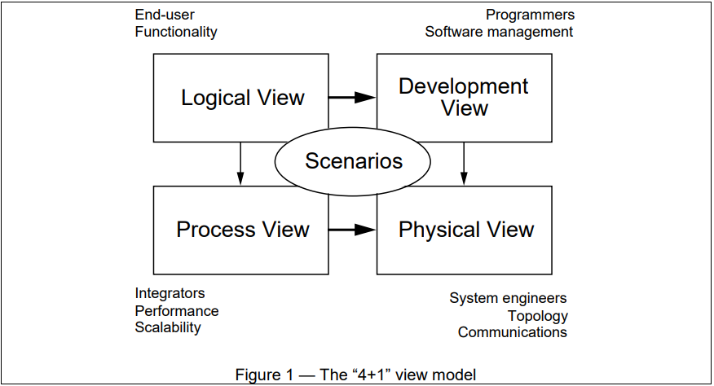
The 4+1 View Model of Architecture
It was developed in 1995 by Philippe Kruchten.

Slide 7
Logical View (Object-oriented Decomposition)
Viewer : End-user
Considers : Functional requirements- What the system should provide in terms of services to its users.
This view shows the components (objects) of the system as well as their interactions / relationships.
UML diagrams – Class, State, Object, Sequence, Communication diagrams.

Slide 8
Process View (The process decomposition)
Viewer : Integrators
Considers : Non - functional requirements (concurrency, performance, scalability)
The process view shows the processes / workflow rules of a system and how those processes communicate with each other.
UML diagrams – Activity diagram

Slide 9
Development View (Subsystem decomposition)
Viewer : Programmers and Software Managers
Considers : software module organization (Hierarchy of layers, software management, reuse, constraints of tools)
It gives a building block view of the system. Eg: Packages Used, Execution Environments, Class Libraries and Sub systems utilized.
UML diagrams – Component, Package diagrams.

Slide 10
Physical Views (Mapping the software to the Hardware)
Viewer : System Engineers
Considers : Non-functional req. regarding to underlying hardware (Topology, Communication)
This view shows the systems execution environment
UML diagram – Deployment diagram.

Slide 11
Scenario / Use case View (Putting it all together)
Viewer : All users of other views and Evaluators.
Considers : System consistency, validity
Validation and illustration to show the design is complete
It is redundant with other views.
UML diagram – Use case diagrams.

Slide 12
Why is it called the 4 + 1 instead of just 5?
The use case view has a special significance.
When all other views are finished, its effectively redundant.
However, all other views would not be possible without it.
It details the high levels requirements of the system.
The other views detail how those requirements are realized.

Slide 13
Thanks

